Slide 1
Digital Tools and
Test-Taking Strategies for the Canadian Adult Education Credential (CAEC)
Odette Lloyd (she/her)
Whitecourt CALP Team Lead

Slide 2

Developed and delivered with financial support from

Slide 3
Land
Acknowledgement

Slide 4
Overview and Objectives
Understand what CAEC is (and is NOT)
Explore digital skills and tasks needed for
online test-taking
Get familiar with the Vretta online testing platform
Prepare for
exam day
Make a
study plan
Practice
digital skills
Manage test anxiety
Notes:
Review outcomes, and learner expectations – i.e. “What do you hope to walk away with at the end of this session?”

Slide 5
The CAEC Tests
Subject | Number of questions | Time
Reading | 50 questions | 75 minutes
Writing | 1 persuasive writing task | 75 minutes
Math Part I: No calculator Part II: Calculator | 42 questions 12 questions 30 questions | 120 minutes 30 minutes 90 minutes
Science | 35 questions | 90 minutes
Social Studies | 40 questions | 90 minutes
Notes:
Approved testing centres may be able to provide extra time as an accommodation for learners with varying needs.

Slide 6
Digital Skills Check-in

Slide 7
Computer Skills for
CAEC Exams
Create, log into and out of an online account
Type letters, numbers, sentences and paragraphs
Use a mouse or touchpad
Recognize links and other “clickable” items
Use menus and buttons to navigate the test
Select and deselect items from a list using
checkboxes or buttons
Select items from a drop-down
“Drag and Drop” items on the screen
Notes:
Other skills you may touch on include reading text or interpreting images on a screen, filling out and submitting online forms, submitting completed test attempts.

Slide 8



Navigating Websites and Online Exams: Cues and Clues
Developed with support from
Notes:
These strategies are based on the “Tech Talk” curriculum, developed by Literacy for Life Foundation, copyright Community Learning Network.

Slide 9





Top “Tech Talk” Tips
Edges are important
Read, read, read
Arrows mean more -
Explore!
Process of elimination
Slow down
Patience and Perseverance
Notes:
Also include
Hover to Uncover
Dot dot dot – whatchya got
Look for “Action Items”

Slide 10
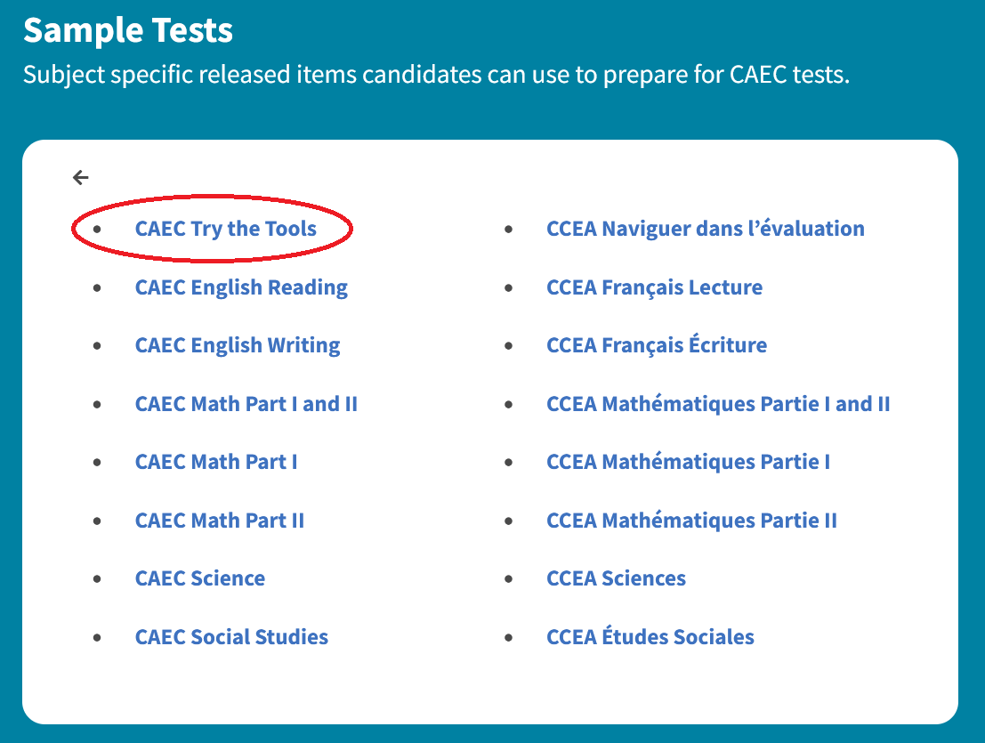
https://caec.vretta.com/#/en/candidate-public-practice

Slide 11
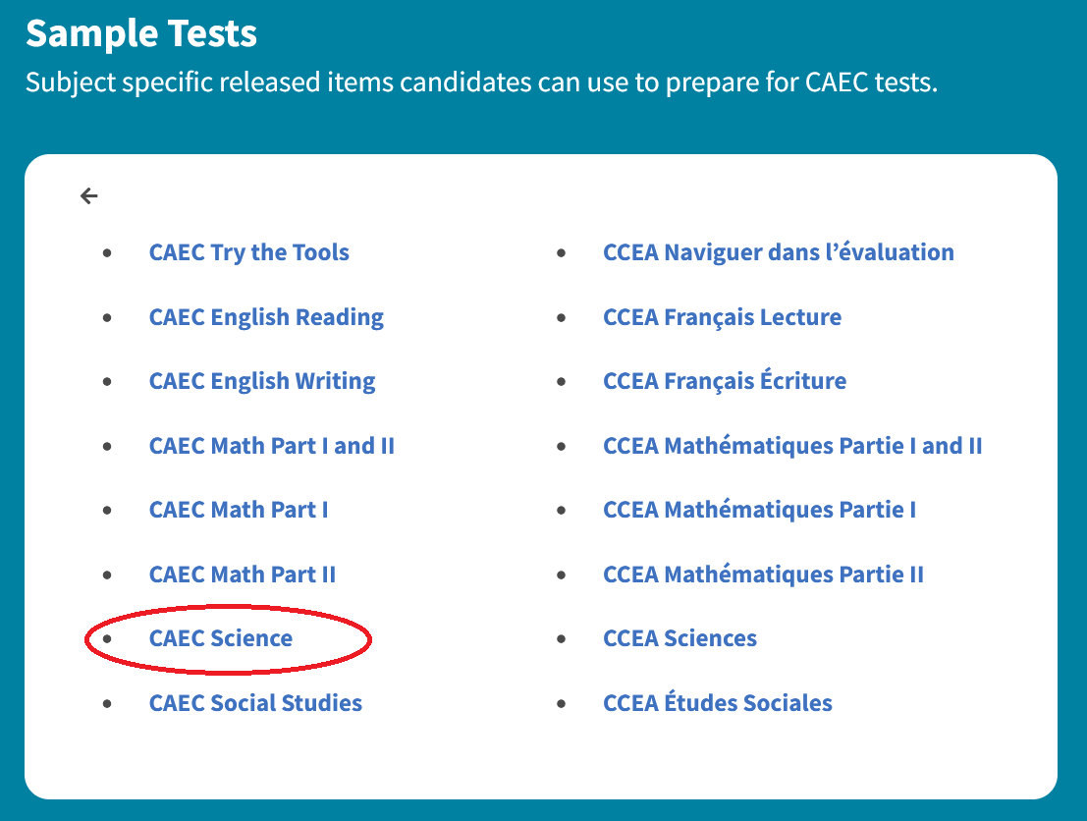
https://caec.vretta.com/#/en/test-auth/shared-test-version/907/4115

Slide 12
Test Prep
Create a study plan and schedule
Set goals and benchmarks
Plan rewards for yourself
Practice using the digital tools on the testing site
Practice going ANALOGUE tools (paper-based)
Visit your test centre ahead of time, so you know what to expect on the day of your exam(s)

Slide 13
Make a Study Plan
You may wish to write all 5 CAEC exams at once, or you may want to study for one exam at a time
Find a planning tool that works for you – there is no right or wrong tool
Schedule time blocks that are from 1.5 – 3 hours for focused study
Have a concrete goal for each study session
Keep rewarding yourself along the way
Notes:
“Concrete goals” could include remembering the names of all the provinces and territories, or writing a persuasive text in 90 minutes or less, for example.

Slide 14
Make a Study Plan
Free tools for scheduling, planning and test-taking
https://sass.queensu.ca/sites/sasswww/files/uploaded_files/Templates%20and%20Documents/April%202025%20Exam%20Study%20Schedule%20fillable.pdf
https://www.developgoodhabits.com/wp-content/uploads/2022/06/Study-Plan-Template-2.pdf
https://libraryresources.senecapolytechnic.ca/assignmentplanner/
https://libguides.norquest.ca/academicskillsforsuccess
Notes:
PDF versions of these pages included as handouts

Slide 15
Practice Digital Skills
AND Analogue Skills
The more confident you feel with your digital skills, the less the online testing format will stress you out.
Vretta includes a lot of digital tools and supports, and that can be overwhelming for some people.
Don’t forget that you are allowed to use old-fashioned pen/paper during your exams.

Slide 16
Free Tools and Games to Improve Your Digital Skills
https://www.typing.com/
https://www.freetypinggame.net/play.asp
http://mnl.mclinc.org/wp-content/uploads/ComputerLab/Mousercise2.0/#1
https://mouse-practice.com/

Slide 17
Ask for Support
Adult learning program providers and testing centres want you to be successful
That’s why we’re here!
Ask for the kind of help you need
Some options may include:
Tutoring, study materials, a quick pep talk, extra time on a test

Slide 18
Managing Test Anxiety
Before – During - After
Study the content
Take regular breaks from studying
Get enough rest
Eat well
Remember to breathe
Reward yourself (have you noticed a theme?)

Slide 19
Managing Test Anxiety
Listen to your own “self-talk”
Identify Common Thinking Traps
  Fortune-telling
  All-or-nothing thinking
  Over-generalization
  Filtering
  Catastrophizing
Notes:
https://www.heretohelp.bc.ca/workbook/test-anxiety

Slide 20
CAEC Content Study Materials
Online anytime CAEC Prep Microcredentials and Courses at NorQuest College
https://www.norquest.ca/programs-and-courses/programs/caec-readiness/
Printable workbooks for Numeracy and Literacy
https://albertaroutes.norquest.ca/lit-resources/
Community Literacy of Ontario CAEC Alignment Project https://www.communityliteracyofontario.ca/all-resources/caec-alignment-project

Slide 21
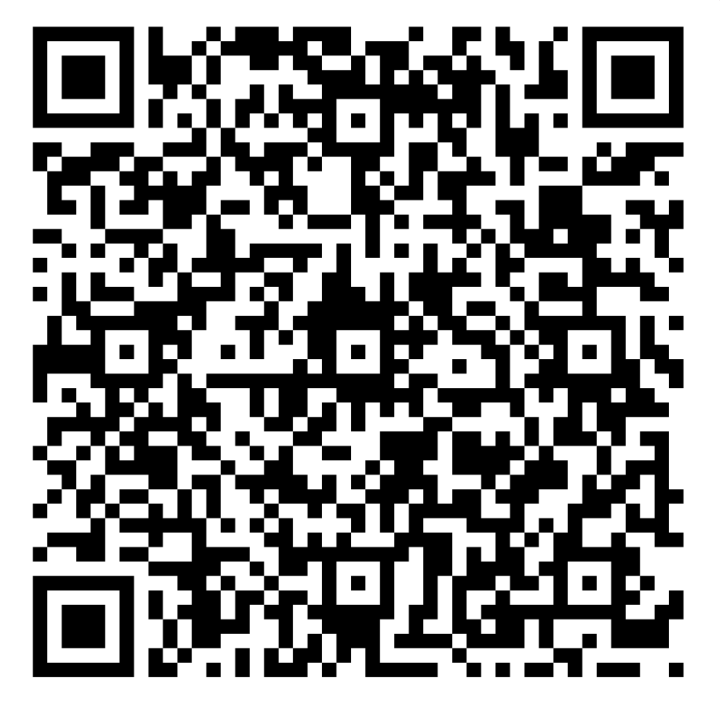
Workshop Feedback Form
https://forms.office.com/r/uvb0FFQQfB
Notes:
You may wish to provide paper copies if participants are still somewhat hesitant with accessing and filling out forms on their phone.

Slide 22
Thank you.
You’ve got this!

